Slide 1
Java Tokens

Slide 2
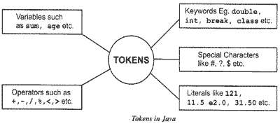
Java Tokens
A java Program is made up of Classes and Methods.
Methods are the Container of the various Statements
Statement is made up of Variables, Constants, operators etc

Slide 3
Java Tokens
Reserved keywords
Identifiers
Literals
Operators
Separators

Slide 4
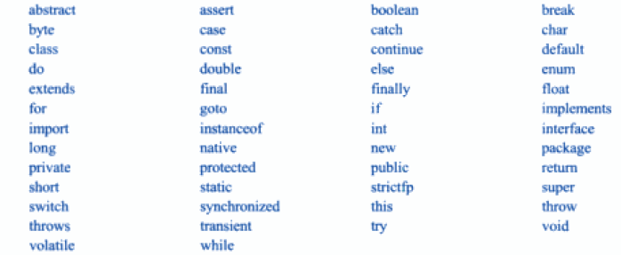
Reserved words

Slide 5

Identifiers/Variables

Slide 6
Literals/Constants
Integer
Character
Floating
Boolean
String

Slide 7
Java Tokens
Operators
Arithmetic operators
Logical operators
Separators
Parentheses, braces, brackets, semicolon, comma, period

Slide 8
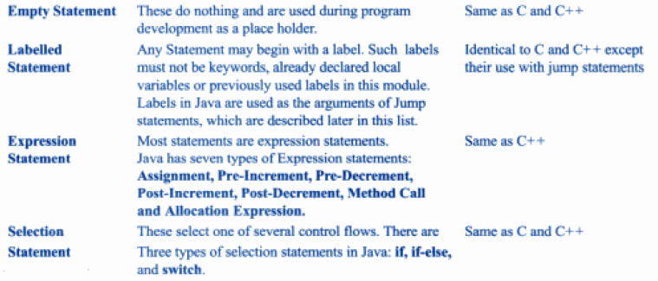
Java Statements

Slide 9
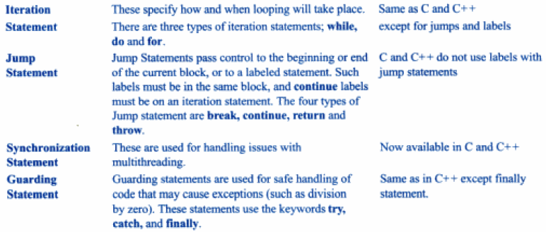
Java Statements

Slide 10
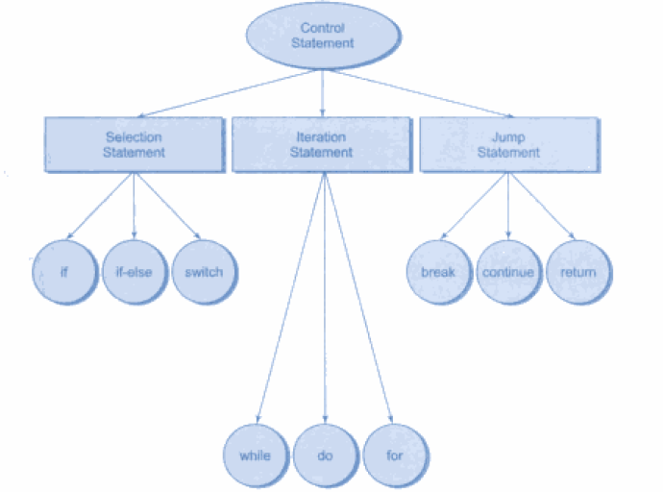
Java Statements

